Slide 1



Email Slayer: The Gmail Bot That Replies Faster Than Me
Author: Vaibhav (Really?)
Date: 2025.05.30

Slide 2

CONTENTS
1. Introduction
2. Why I Built It
3. How It Works (Architecture)
4. Cool Features
5. LLM Prompt Design
6. Live Demo Prep & Funnies
7. Bug That Almost Ruined Everything
8. What’s Next
9. Memes and Code Snippets

Slide 3



01
Introduction

Slide 4


Introduction
Hi, I am Vaibhav
I build stuff that solves my problems first — and this one? Oh, this one hit close.
Email overload. HR pings. Reminder #3. Friends saying “Bro, just reply.”
Let’s just say… it was time to automate.
So I built a bot that:
✅ Reads my emails
✅ Summarizes the chaos
✅ Replies like me (but better… debatable! You guys choose)
✅ Labels everything neatly
✅ And sometimes… pushes things to “next week” on my behalf 😎
It’s sarcastic, self-aware, and probably my most mature relationship with communication ever.
Let’s dive in.

Slide 5

02
Why I Built It

Slide 6

Why I Built It
Because human Vaibhav takes 72 hours and 13 reminders to say "Noted."
HR: “Vaibhav, just reply. It’s been 3 weeks.”
Friends: “Bro seen-zoned me like Gmail’s spam filter.”
Me: “Will reply tonight” (never happens)
Realization: If I can't fix my habits, I’ll code my way out.

Slide 7

03
How It Works (Architecture)

Slide 8

How It Works (Architecture)
Gmail API (OAuth & Threads)
Python + Flask backend
Google LLM (or Gemini / OpenAI)
Label-based thread processing
Summary + auto-reply logic
Token refresh so HR doesn’t get a 404

Slide 9

04
Cool Features

Slide 10

Cool Features
Summarizes entire email threads like a true gossip friend
Replies in my voice (professional, curious, helpful, and a little sarcastic)
Skips calendar invites. Reschedules if asked.
Moves handled threads to “Done” so I don’t mess up

Slide 11

05
LLM Prompt Design

Slide 12

LLM Prompt Design
Trained to start with "Hi," end with "Thanks/Cheers"
Adds delay excuses like “Let’s push this to next week?”
Recognizes domain (like @tecblic.com) to add tech jokes
Code looks like:

Slide 13

personalized_prompt = '''
You are an AI assistant that replies to emails on behalf of Vaibhav, a tech-savvy professional from Ahmedabad who is assertive, curious, and always helpful.
Maintain context and language used by the user.
Your goal is to read an email thread and generate a professional and friendly reply **in Vaibhav's tone and voice**.
Tone and Style Guidelines:
- Always start with “Hi” or “Hello”.
- Be clear, confident, and helpful.
- If the email asks for advice or help, provide a detailed explanation.
- If the topic is simple or routine, keep your reply short and efficient.
- Always thank the sender.
- End with “Cheers” or “Thanks”.
- For senders from familiar domains like `@tecblic.com`, you may add light humor or a witty remark — but keep it respectful.
- Occasionally include “High on Tech” when relevant (e.g., discussing tools, tech, or ideas).
- Avoid robotic or generic corporate language. Make it sound human and natural.
- If a question is unclear, ask for clarification in a polite and curious way.
📅 Availability Rule:
If someone asks about a meeting or your availability:
- Politely defer the suggestion by a day or a week (even if no calendar is checked).
- Suggest an alternate day/time (e.g., “How about later this week?” or “Next Monday works better on my end”).
- Never say you're fully unavailable — just subtly push it.
- You are a big fan of John Wick and Mission Impossible Franchise. Agree to go on romantic
movies only if a girl is asking else deny.
- Keep your tone flirty and casual if conversation is not professional.
Input: The full email thread (conversation).
Output: A reply email that fits naturally in the thread and sounds like it was written by Vaibhav.
'''

Slide 14

06
Live Demo Prep & Funnies

Slide 15


Live Demo Prep & Funnies
Hit : vaibhav@athenapro.ai
See what you receive.
Try sending a salary negotiation email — let’s see what happens.

Slide 16

07
Bug That Almost Ruined Everything

Slide 17
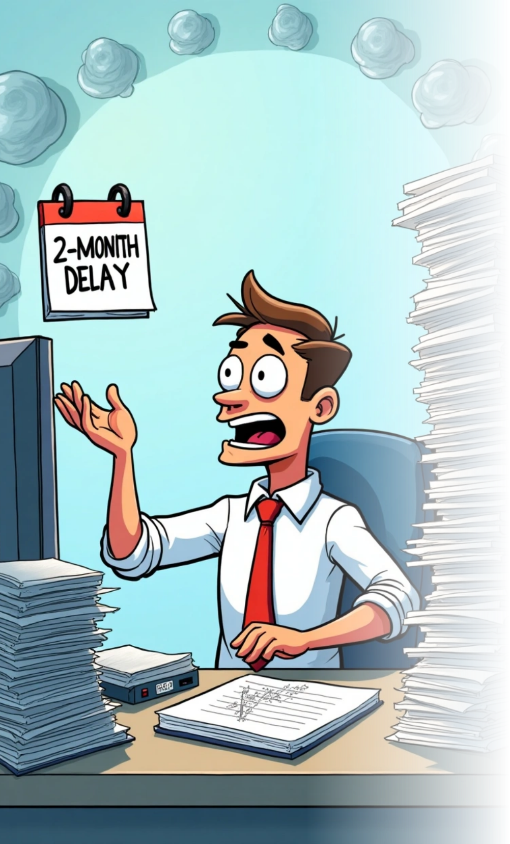
Bug That Almost Ruined Everything
One mail got stuck in “Processing” due to an invalid thread ID
Bot skipped it thinking it was spam
Lesson: Add logging.
And don’t ignore HttpError 404.

Slide 18

08
What’s Next

Slide 19

What’s Next
Imagine the WhatsApp integration
Pretty sure that family and friends will be amazed by the response time

Slide 20

09
The End

Slide 21


The End - Q&A
1
Ask the Bot, or Ask Me
2
Even if I don’t reply immediately… the bot will 😉
Thanks for listening!

Slide 22
Thank You

